Slide 1
DEALER INTRODUCTION
EDUCATIONAL TUTORIAL
Notes:
‹#›

Slide 2
WATER’S EFFECT
ON THE BODY
Moistens tissues such as those in the mouth, eyes and nose
Regulates body temperature
Protects body organs and tissues
Lubricates joints
Lessens the burden on the kidneys and liver by flushing out waste products
Helps prevent constipation
Helps dissolve minerals and other nutrients to make them accessible to the body
Carries nutrients and oxygen to cells
LifeIonizers.com
Notes:
‹#›
It serves many functions in the body that you may not be aware of
IT….
Moisten tissues like in the mouth, eyes, and nose
It protects organs and other internal parts
It helps prevent constipation and cleanses the digestive tract
It helps the absorption of vitamins and minerals
It regulates body temperature
It keeps joints lubricated
It helps flush out toxins from the liver and kidneys
And finally, it helps deliver oxygen to our cells

Slide 3
LOOKING AT THIRST OVER
A ONE DAY PERIOD
06:00
WAKE UP
WHEN YOU WAKE UP
Your body is dehydrated in the morning.
You lose 12 oz. of body fluid during sleep.
12:00
WORKING
AT THE OFFICE OR SCHOOL
Don’t neglect thirst at your desk.
Your body fluid decreases.
15:00
EXERCISE
WHEN EXERCISING
Be careful with excessive perspiration.
18:00
BATH TIME
DURING BATH TIME
You perspire more than you imagine.
00:00
SLEEPING
WHILE SLEEPING
This is when your body is most thirsty.
LifeIonizers.com
Notes:
‹#›
Dehydration occurs 24 hrs. a day
It happens while you sleep, work, bathe, exercise, even when you breath!
The average adult loses 10 cups of water on a normal day
In hot or humid weather it can be up to 8 cups an hour!
Food only accounts for about 20% of water intake a day
This is why its so important that you drink enough water each day!

Slide 4
THE FACTS ABOUT
DEHYDRATION
Our muscle and brain tissue is roughly 70% water, yet it’s estimated that over 75% of Americans are chronically dehydrated
Research indicates that 8-10 glasses of water a day could significantly ease joint and back pain for up to 80% of sufferers
Over 37% of Americans thirst mechanism is so weak that it’s often mistaken for hunger
#1 trigger of daytime fatigue
A mere 2% drop in body water can trigger short-term memory loss, trouble with basic math and difficulty focusing on the computer screen or a printed page.
8 glasses of water per day can ease chronic constipation and may even make you look 10 years younger
Even mild dehydration will slow down the metabolism as much as 3%
Studies show that athletic performance diminishes with as little as 2% body dehydration
LifeIonizers.com
Notes:
‹#›
So how do you know when you’re dehydrated?
One easy way is to check your urine. Your urine should be light in color. If its dark then that is a sign you’re dehydrated.
If you feel thirsty, this mean that you have already been dehydrated for a long time.
LIST FACTS
Over 75% of american’s are chronically dehydrated
Research indicates that 8-10 glasses of water a day can reduce joint and back pain
Over 37% of American’s confuse thirst with hunger because they have been dehydrated for so long
It can be the #1 reason why you feel tired during the day
Just a 2% drop in body water can cause short term memory loss
5 glasses of water a day can significantly reduce colon
, breast cancer, and bladder cancer
Even being a little dehydrated can slow down your metabolism and athletic performance

Slide 5
DRINK ALKALINE WATER
FOR YOUR HEALTH
Fights acid reflux
Mental Focus
& Clarity
Supports
Immune System
Superior
Hydration
Supports healthy probiotics
Ionized Minerals Are
More Bioavailable
Improved Energy,
Stamina, & Endurance
UP TO
6X
Maintains healthy bones
MORE HYDRATING
LifeIonizers.com
Notes:
‹#›
Research shows that alkaline water hydrates up to 6 times better than bottled water or tap water
LIST BENEFITS
ROBYN WILL REVIEW

Slide 6
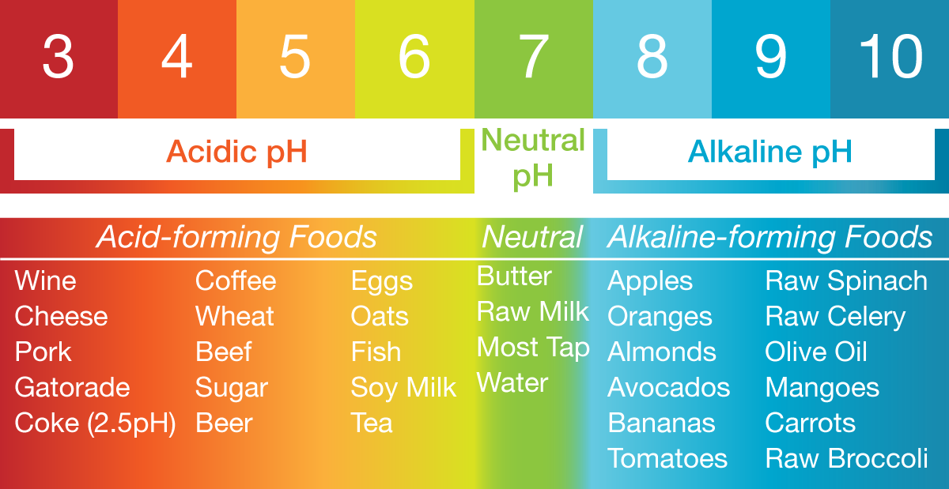
ARE YOU EATING ALKALINE?
LifeIonizers.com
Notes:
‹#›

Slide 7
REASONS TO DRINK
ALKALINE WATER
Research shows that raising the pH of your urine by just 1 pH may prevent or eliminate the symptoms of metabolic syndrome:
Obesity
High blood pressure
High blood cholesterol
High blood sugar
Kidney stones
One study on alkaline water’s ability to reduce blood pressure showed that alkaline water supplied beneficial levels of calcium and magnesium even for people with health problems that impair their ability to absorb those minerals
Alkaline water has been shown to reduce oxidative stress in the body that affects the liver. A recent study showed an average 43% reduction in t-bars – (thiobarbituric acid reactive substances) – chemicals in the body that cause liver damage.
Alkaline water has also been shown to increase levels of a critical antioxidant that protect the liver. Superoxide dismutase - (sod) breaks down bad cholesterol and hydrogen peroxide in the liver. Higher levels of sod in the liver help cleanse blood efficiently.
LifeIonizers.com
Notes:
‹#›
There’s a lot of research that proves why alkaline water is beneficial.
Raising the pH by just 1 point can prevent issues such as obesity, high blood pressure, high cholesterol, high blood sugar, and kidney stones
Alkaline water can help reduce blood pressure because it supplies calcium and magnesium even for people that cant absorb it very good.
It can also reduce oxidative stress in the liver. One study found a 43% reduction in chemicals that cause liver damage and an increase in liver antioxidants

Slide 8
MORE REASONS TO DRINK
ALKALINE WATER
A study looked at groups of people which included people with digestive problems that cause mineral deficiencies. The study showed that alkaline water provided increased mineral absorption even in the presence of clinical digestive deficiencies.
Alkaline water has an antacid effect which can lead to fewer upset stomachs, and improve overall digestive health. Measurement of stomach pH levels after drinking alkaline water showed that stomach pH increased by .5 to 1 pH. The beneficial antacid effect lasted for a half hour after the water was used.
Research on women over 75 years of age shows that drinking alkaline water led to significant decreases in two indicators that doctors use to measure the rate of bone loss. Parathyroid hormone (pth) – controls calcium and phosphorus levels. Serum c-telopeptide (ctx) – used to measure bone turnover.
Age-fighting antioxidants - drinking alkaline water has been shown to increase antioxidant levels in the body by an average of 38% and reduce the levels of damaging free radicals by 43% according to research. Researchers in the most recent study reported that antioxidant levels of test subjects improved significantly in just 4 weeks!
Alkaline Water Hydrates You Better
Alkaline water mixed with electrolytes provides a noticeable performance boost, and helps the body retain the water it needs. Electrolytes are composed of minerals like potassium and calcium. Your body absorbs minerals from water 30% faster and easier than it does from food or supplements – so drinking water is the best way to get your electrolytes. Electrolytes taken with alkaline water are absorbed even faster, you can actually feel the difference!
LifeIonizers.com
Notes:
‹#›
ROBYN WILL PROB ADD AFTER EACH ONE
Alkaline water can help with mineral deficiencies even for people who have clinical digestive issues
It also has an ant-acid effect and can help with upset stomach and heartburn
Research shows that alkaline water can reduce bones loss in women over the age of 75
It is proven to raise the antioxidants in the body by and average of 38% and can reduce free radicals by 43%

Slide 9
ALKALINE WATER
May Help With
FATIGUE
DIARRHEA
HEARTBURN
DIGESTIVE ISSUES
BONE DENSITY ISSUES
DEHYDRATION
POOR CIRCULATION
JOINT PAIN
LEG CRAMPS
STRESS
HIGH BLOOD PRESSURE
REGULATING BLOOD SUGAR
WEIGHT ISSUES
MIGRAINES
NAUSEA
Notes:
‹#›
LIST BENEFITS

Slide 10
MORE REASONS TO DRINK
ALKALINE WATER
In 2010, the MSU health and human department, Professor Dan Heil and a team of graduate and undergraduate students conducted a study that found that individuals drinking alkaline water were better hydrated and had higher pH levels than those who consumed non-alkaline water.
LifeIonizers.com
Notes:
‹#›
ROBYN WILL ADD SOMETHING AFTER
In 2010, the MSU health and human department and professor Dan Heil performed a study which showed that alkaline water can actually raise the pH in blood and urine
The results only took two week to show an increase
At 4 weeks they were put back on regular bottled water and the pH levels decreased

Slide 11
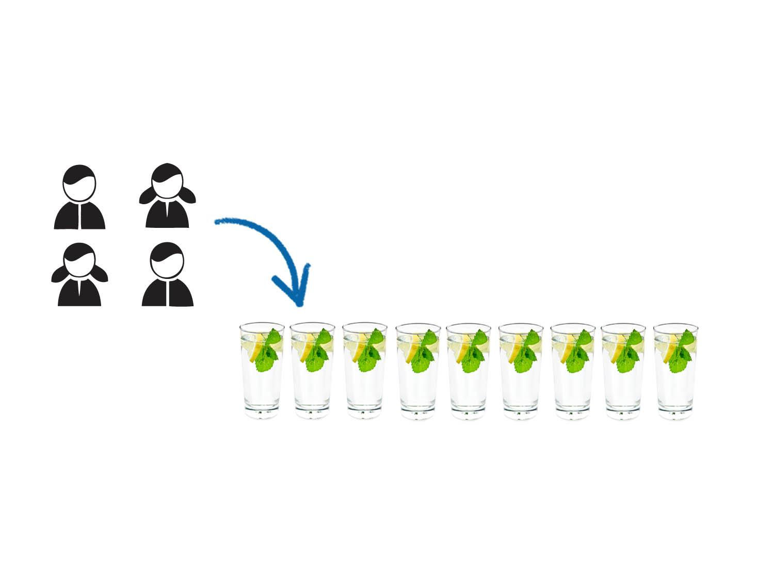
ALKALINE WATER
FOR WEIGHT LOSS
Based on Clinical Research
Study:
Effect of daily consumption of 2 liters of
electrolyzed water for 2 months
Study participants made no changes to their
diet other than consuming alkaline water.
2 Men, 2 Women
Results:
Beginning: 255 lbs.
Month One: 249 lbs.
Month Two: 243 lbs.
12 lbs. lost in Two Months!
LifeIonizers.com
Notes:
‹#›
The pH scale is logarithmic. For every 1 point change, the effect is multiplied by 10 times. It ranges from 0-14. Anything from 0-6.9 is considered acidic, anything between 7.0 – 7.5 is considered neutral, and anything from 7.6-14 is considered alkaline.
So, what does your diet consist of. If you look at the chart, the average American diet which consists of wheat, pasta, dairy, and meat is extremely acidic.
The pH of blood is about 7.4. So, for example wheat has a pH of 4.0 which is about 3.4 points lower. Based on the scale, this is more than 1000 times more acidic than your blood pH.
It takes 20 parts alkaline to neutralize 1 part acidity
Lets look at some alkaline foods:
Raw vegetable are always the best. They have the highest alkaline levels
Raw Spinach has one of the highest pH levels which is about 10
Avacodos, Mangos, olive oil, artichokes, bell peppers, are all alkaline
What type of water do you drink right now? Chances are its over-process bottled water. Bottled water is treated so that everything is removed from it. The minerals are also removed which makes it acidic. Demineralized water doesn’t absorb well in the body.
Alkaline water is rich in minerals which are absorbed 30% better than from bottled water

Slide 12
ALKALINE WATER SHOWN TO
LOWER CHOLESTEROL
Based on Clinical Research
Study:
Effect of daily consumption of 2 liters of
electrolyzed water for 2 months
Study participants made no changes to their
diet other than consuming alkaline water.
2 Men, 2 Women
Results:
Average Reduction in total cholesterol
was 17 mg/dl
Most significant reductions were seen in triglyceride levels - A reduction of 32.8 mg/dl!
LifeIonizers.com
Notes:
‹#›

Slide 13
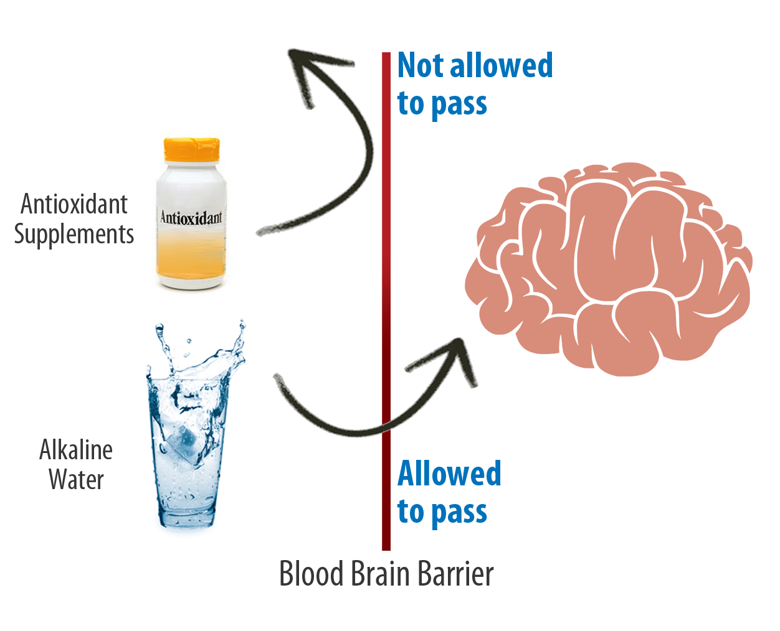
BRAIN HEALTH AND
ALKALINE IONIZED WATER
Oxidative stress to brain cells is a major factor in age-related neurodegenerative diseases such as Alzheimer’s and Dementia.
A new study documents laboratory testing that alkaline water from a water ionizer has been shown to reduce or prevent the oxidative damage to brain cells that leads to those neurodegenerative diseases.
When we age, the body’s antioxidant and detoxification systems decline.
The body is then unable to detoxify itself from harmful oxidants AND the body is not producing enough antioxidants to counter the negative oxidants.
Traditional antioxidants in food and supplements cannot help because of the blood brain barrier.
The blood brain barrier separates the brain from the rest of the body’s circulatory system to prevent harmful substances in the blood stream from entering the brain.
Unfortunately, it also prevents antioxidants from entering the brain, so they can’t prevent the oxidative damage that happens there.
Alkaline water can cross the blood brain barrier, so it is believed to be an ideal way to deliver anti-oxidative protection to the brain.

Slide 14
HOW DOES THE IONIZER WORK?
ANTIOXIDANTS
Oxidation Reduction Potential (ORP) is a way to measure
antioxidants in water by testing its electrical charge
(+) Positive ORP = free radicals (bad) (-) Negative ORP = antioxidants (good!)
Alkaline ionized water has a very strong (-) negative ORP, lots of electrons!
Antioxidants (-) neutralize free radicals (+)
Antioxidants can help prevent disease like cancer, cardiovascular disease, immune dysfunction, and much more!
Notes:
‹#›
There are more antioxidants in alkaline water than you can imagine.
Antioxidants are created when a free radical steals and electron from the cell which makes the cell unstable.
The cell is under oxidative stress
When the antioxidant comes in, it donates an electron to the free radical which then stabilizes it.
LIST ORP info

Slide 15
Alkaline and Hydrogen in One Machine
HYDROGEN POWER
To get hydrogen from water, you need a lot of power because you have to split water molecules. Water molecules are made of two hydrogen atoms and one oxygen atom, and those atoms are tightly bonded. Top-of-the-line LIFE Ionizers with Hydrogen XL technology can crank out up to 800 watts of power, the most power of any ionizers made. All that massive power enables a LIFE Ionizer to split more water molecules and release more hydrogen than any other brand of ionizer.
Life Ionizers MXL is capable of producing
5.2 parts per million molecular hydrogen
in every glass!
The next highest competitor makes less than half of that!
Notes:
‹#›
There are more antioxidants in alkaline water than you can imagine.
Antioxidants are created when a free radical steals and electron from the cell which makes the cell unstable.
The cell is under oxidative stress
When the antioxidant comes in, it donates an electron to the free radical which then stabilizes it.
LIST ORP info

Slide 16
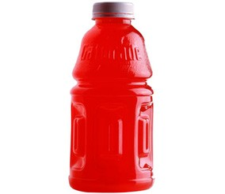
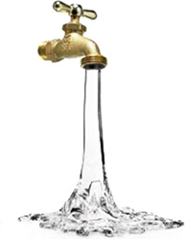
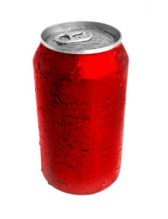
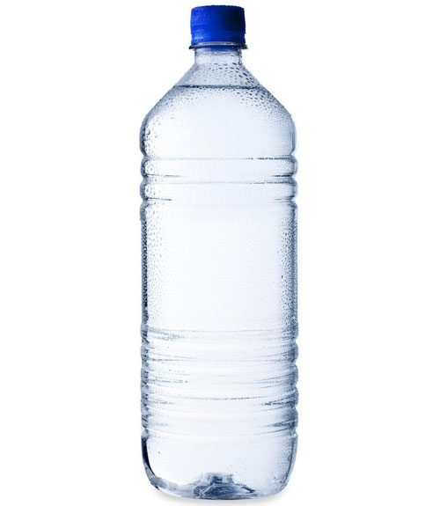
ORP VALUES
Coffee Sports Drinks Soda Bottled Water Juice Tap Water
+175
+440
+410
+295
+200
-100 (Fresh)
+300-500
Life Ionizers Alkaline Water: -500 MV to -1005 MV!
Positive = BAD Negative = GOOD
Notes:
‹#›
ROBYN MAY TALK AFTER
Here are some ORP values of common drinks
Keep in mind that positive is bad and negative is good
LIST ORP VALUES

Slide 17
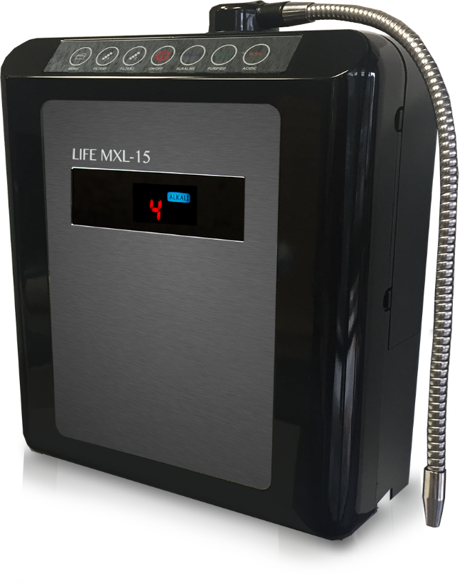
ORP range at a 9.5 pH
COMPARISON
MXL-5: up to -500
MXL-7: up to -700
MXL-9: up to -800
MXl-11: up to -880
MXl-13: up to -900
MXL-15: up to -1005

Slide 18
REFERENCES
[Rylander R, Arnaud M, Mineral water intake reduces blood
pressure among subjects with low urinary magnesium and calcium
levels. BMC Public Health 2004.
http://www.biomedcentral.com/1471-2458/4/56
Heil, P and Seifert, J. Influence of bottled water on rehydration
following a dehydrating bout of cycling exercise. Journal of the International
Society of Sports Nutrition Retrieved from Springerlink:
http://www.springerlink.com/content/kn41764j65165u3x/fulltext.pdf
Maalouf N. et. al. Low Urine pH: A Novel Feature of the Metabolic
Syndrome University of Texas Southwestern Medical Center,
Dallas, Texas
Integrated Health Services. Academia – The Hidden Menace
Retrieved from:
http://www.inhealthservices.com.au/FRT_acidemia.htm
Sutton JR, Jones NL, Toews CJ. Effect of PH on muscle glycolysis
during exercise. PubMed.gov.
http://www.ncbi.nlm.nih.gov/pubmed/7261554
Sutton JR, Jones NL, Toews CJ. Effect of PH on muscle glycolysis
during exercise. PubMed.gov.
http://www.ncbi.nlm.nih.gov/pubmed/7261554
Abraham, Guy, and Jorge Flebas. “The effect of daily consumption of 2 liters of electrolyzed water for 2 months on body composition and
several physiological parameters in four obese subjects: a preliminary report.” Highbeam Research. Original Internist, 01 Sep 2011. Web. 2 Jul 2013. http://www.highbeam.com/doc/1G1-269433201.html
Holsworth, R, , and et al. “Effect of Hydration on Whole Blood Viscosity in Firefighters.” ebscohost. Alternative Therapies, n.d. Web. 27 Dec 2013. http://web.ebscohost.com/ehost/pdfviewer/pdfviewer?sid=d19a888b-bdf2-4a84-8138-fca11b03df01@sessionmgr4005&vid=2&hid=4112
Heil, D. “Acid-base balance and hydration status following consumption of mineral-based alkaline bottled water..” Journal of the International Society of Sports Nutrition. Journal of the International Society of Sports Nutrition, 13 Sep 2010. Web. 26 Mar 2014. http://www.jissn.com/content/7/1/29
Coassin, M. Ursini, F. Bindoli, A. Antioxidant effect of Manganese.
Archives of Biochemistry and Biophysics Volume 299, Issue 2,
December 1992, Pages 330-333
http://www.sciencedirect.com/science/article/pii/0003986192902822
TH Tulchinsky. Micronutrient deficiency conditions: global
health issues. Public Health Reviews 2010;32:243-255.
http://www.publichealthreviews.eu/show/f/28
Wynn, E. et al. Postgraduate Symposium Positive influence
of nutritional alkalinity on bone health; Conference on ‘Over- and
undernutrition: challenges and approaches The Proceedings of the
Nutrition Society. Cambridge: Feb 2010. Vol. 69, Iss. 1; pg. 166, 8 pgs
Kitahora, et al: “Electrolytic Water in Medical Treatment” Symposium
of the 25th General Assembly of the Medical Congress of
Japan (1999)
Integrated Health Services. Acidamia – The Hidden Menace
Retrieved from:
http://www.inhealthservices.com.au/FRT_acidemia.htm
Gasnarrini G et al. Effects of bicarbonated-alkaline water
(Uliveto) on gastric and gallbladder emptying in normal subjects.
Ultrasonic evaluation
http://www.ncbi.nlm.nih.gov/pubmed/2000176
Fornai, M et al. Effects of a bicarbonate-alkaline mineral water
on digestive motility in experimental models of functional and
inflammatory gastrointestinal disorders.
http://www.ncbi.nlm.nih.gov/pubmed/18773120
Heil, P and Seifert, J. Influence of bottled water on rehydration following a dehydrating bout of cycling exercise. Journal of the International Society of Sports Nutrition Springerlink July 2009. http://www.springerlink.com/content/kn41764j65165u3x/fulltext.pdf
Notes:
‹#›
Here are references for the information we just went over. This is just a small sample of what research is available.

Slide 19
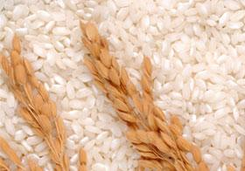
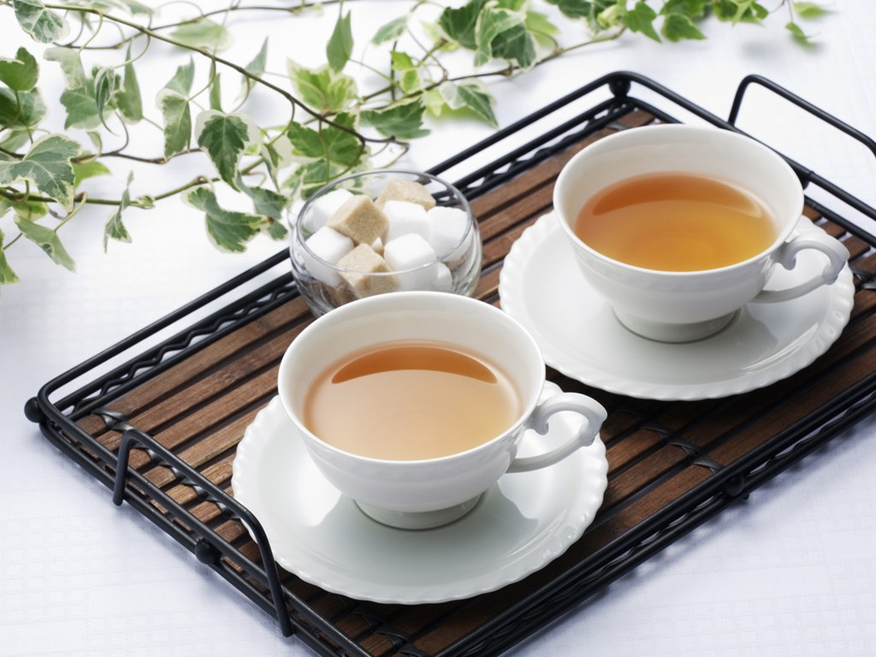
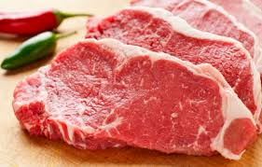
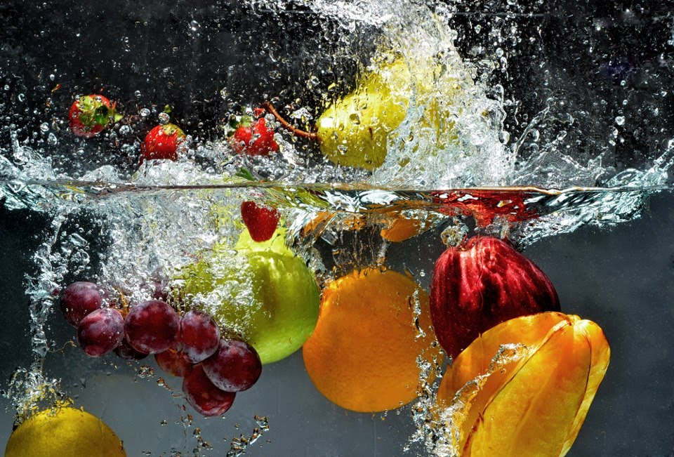
ALKALINE WATER
IN THE KITCHEN
MAKES FOOD, COFFEE AND TEA TASTE GREAT!
FLUFFIER GRAINS AND RICE
TENDERIZE AND MARINATE MEATS
CLEAN AND REVITALIZE FRUITS AND VEGETABLES BY SOAKING FOR 20 MINUTES
DRINK 30 MINUTES BEFORE EATING TO IMPROVE DIGESTION
Notes:
‹#›

Slide 20
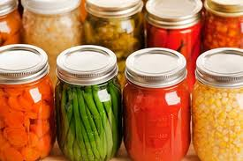
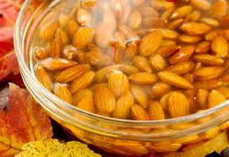
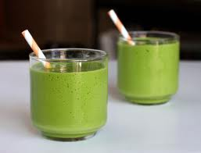
Other ALKALINE
WATER USES
SOAKING & SPROUTING SEEDS, NUTS, GRAINS & MORE
STORAGE OF VEGETABLES TO LAST LONGER
IMPROVE FLAVOR TO SOUPS
AND STEWS
ADD 1 TBSP TO SALAD DRESSINGS TO KEEP OIL EMULSIFIED
SWEETER TASTING JUICES & SMOOTHIES
Notes:
‹#›

Slide 21
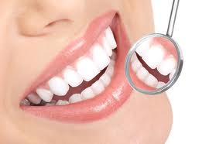
ACIDIC
WATER USES
NATURAL ASTRINGENT
NATURAL HAIR CONDITIONER
SANITIZE WITHOUT CHEMICALS
REMOVES PLAQUE FROM TEETH
ANTISEPTIC
MOUTHWASH
TREATS SUNBURNS
TREATS SKIN CONDITIONS
TREATS BUG BITES
TREATS
ECZEMA
TREATS
ACNE
Notes:
‹#›

Slide 22
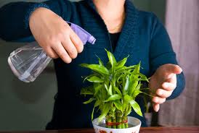
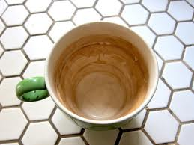
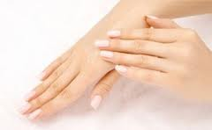
MORE ACIDIC
WATER USES
EXTENDS LIFE OF CUT FLOWERS
WATERING PLANTS
MOUTH
SORES
BATHE PETS FOR NICER COATS
CLEANS COFFEE & TEA STAINS FROM CUPS
ROUGH SKIN
BLISTERS
RASHES
Notes:
‹#›

Slide 23
TESTIMONIALS
Anderson started making small lifestyle changes 13 years ago after being diagnosed with Type 2 diabetes.
"I started eating healthier and in moderation, but I was still sort of eating the same stuff that I'd been eating all my life," he admits.
That all changed in 2008. "When I was cast in Law & Order, I decided to make a drastic change," says Anderson. "I got more serious about my health and appearance – not from a vanity standpoint. I just started making healthier choices."
Recently, he has taken healthy eating to the next level by using the Life M11 Water Ionizer along with his other healthy lifestyle choices.
Anthony Anderson
Professional Actor
LifeIonizers.com
Notes:
‹#›
Craig Oster PHD believes that his LIFE Ionizer and alkaline water is a key part of his healing program for his ALS
Barry Zito MLB pitcher uses alkaline water all year long for great results in his training
Dr. Johnnie Ham MD and his family use it everyday and have seen incredible benefits

Slide 24
TESTIMONIALS
Debra Messing added Life alkaline ionized water to her healthy lifestyle and has seen great results:
"I’ve got my very own Fountain of Youth and I’d like to tell you about it: I got my Life Ionizer when I heard about the amazing health benefits of alkaline water. I chose Life after I tried the water for myself; it is the most refreshing water I’ve ever drank! Plus, it feels amazing. I have the energy I need to keep up with my busy schedule, and I feel great! It makes a big difference in my health and my lifestyle, and I know it will in yours too."
Debra Messing
Professional Actor
LifeIonizers.com
Notes:
‹#›
Craig Oster PHD believes that his LIFE Ionizer and alkaline water is a key part of his healing program for his ALS
Barry Zito MLB pitcher uses alkaline water all year long for great results in his training
Dr. Johnnie Ham MD and his family use it everyday and have seen incredible benefits

Slide 25
TESTIMONIALS
Raymond Floyd
Professional Golfer
“I purchased a Life Ionizer for my Summer home and in just a short time I could tell the difference. My three Children now have them for their families and could not be happier. I highly recommend Life Ionizer for your overall well being.”
Miguel Cotto
4x World Boxing Champion
“I love my Life Ionizers water filtration system. With the heavy demands of very intense training periods, I have to rely heavily on quality sources of water. Life Ionizers has become a very convenient and reliant aspect of my program.”
Marc Mariani
NFL Wide Receiver
“I use the Life Ionizer every day and it has become an essential part of my daily regiment on and off the field!”
2011 NFL Pro-Bowler
NFL Pro Bowl Record for Most Return
yards in a game (326) and most returns (9)
LifeIonizers.com
Notes:
‹#›
Here are some testimonials from some very happy LIFE Ionizer customers
Dr. Don Colbert who’s a NY Times best Selling Author believes alkaline water is the healthiest water available
Travis Illian who’s a personal trainer for the University of Alabama didn’t experience anymore joint stiffness after only 3 months of using alkaline water
Dr. Sherry Rogers MD believes that alkaline water rids the body of acidic waste which she thinks is the primary cause of degenerative disease

Slide 26
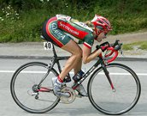
TESTIMONIALS
Cecil Fielder
14 Year MLB Veteran
“I drink it, my family drinks it, and it had made a huge impact on our lives. Life Ionizers is really the best of the best when it comes to filtration and alkaline water ionization.”
Barry Zito
MLB Veteran
“LIFE Ionizers water filters/alkalizers enable me to stay hydrated throughout both my arduous season and off-season cycles. While in season, it helps me beat muscle fatigue and ensure I make every start, and in the off-season, it allows me to get the maximum potential out of my 3 months of workouts.
Dotsie Bausch
Professional Cyclist
“Drinking alkaline water over the past month has really made a difference for me. I had a hydration saturation test done pre and post alkaline water consumption and the numbers don't lie. I love my Life Ionizer and alkaline water! Thanks so much!”
LifeIonizers.com
Notes:
‹#›
Here are some testimonials from some very happy LIFE Ionizer customers
Dr. Don Colbert who’s a NY Times best Selling Author believes alkaline water is the healthiest water available
Travis Illian who’s a personal trainer for the University of Alabama didn’t experience anymore joint stiffness after only 3 months of using alkaline water
Dr. Sherry Rogers MD believes that alkaline water rids the body of acidic waste which she thinks is the primary cause of degenerative disease

Slide 27
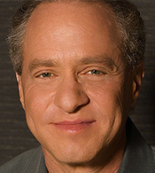
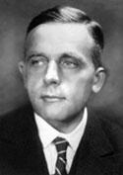
ALKALINITY
IN THE BODY MATTERS
Anthony Robbins
Inspirational Psychologist
“Alkalize your body and live a healthier, more energized, and ultimately more fulfilling life. Our acid-alkaline balance is a baseline determinant of our physical health. When you break your old eating patterns, you will find yourself getting back to the real you, filled with the vitality and energy that your desire and deserve.”
Ray Kurzweil
Author, Inventor & Futurist
“There are more benefits to "alkaline water" than simply the alkalinity or pH. The most important feature of alkaline water produced by a water Ionizer
is its oxidation reduction potential (ORP). Water with a high negative ORP
is of particular value in its ability to neutralize oxygen free radicals.”
Dr Otto Heinrich Warburg
“Dr. Otto Warburg discovered the root cause of cancer in 1923 and he received the Nobel Prize for doing so in 1931. Dr. Warburg was director of the Kaiser Wilhelm Institute (now Max Planck Institute) for cell physiology at Berlin. He investigated the metabolism of tumors and the respiration of cells, particularly cancer cells. Below are some direct quotes by Dr. Warburg during medical lectures where he was the keynote speaker.”
Notes:
‹#›
Craig Oster PHD believes that his LIFE Ionizer and alkaline water is a key part of his healing program for his ALS
Barry Zito MLB pitcher uses alkaline water all year long for great results in his training
Dr. Johnnie Ham MD and his family use it everyday and have seen incredible benefits

Slide 28
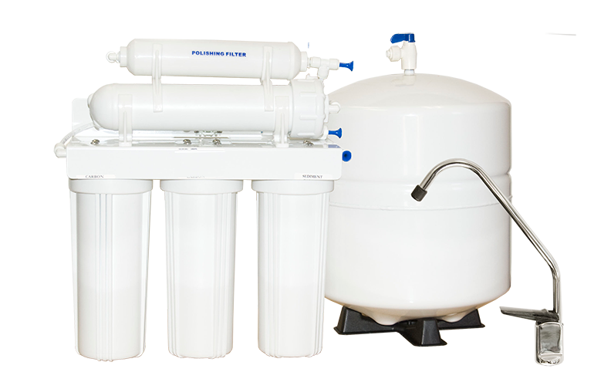
UNIQUE
PRE-FILTRATION
LIFE 5-STAGE REVERSE OSMOSIS & REMINERALIZER
*BEST USED WITH UNDER-COUNTER MODELS
Removes up to 99% of all contaminants, impurities, bacteria, sediment, salt from water softener, scale, etc.
50 gallon per day capacity
Holds 3-gallons of water
Creates approx. 1.5 gallons of alkaline water
Limited volume and water flow
Automatic shut off valve
5-purification stages
Remineralizer adds 73 organic minerals
Filter life: 12 months
No additional pre-filters needed
LifeIonizers.com
Notes:
‹#›

Slide 29
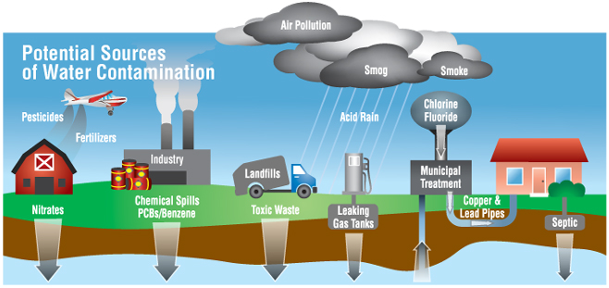
HOW DOES AN IONIZER WORK?
WATER QUALITY
& FILTRATION
WATER QUALITY
Why LIFE Ionizers is different:
Custom water report analysis
Custom calibration for water quality
Heavy metals
2 Internal filters
9 Stages of filtration
Optional pre-filters
Optional reverse osmosis & remineralization
UV light optional for bacteria
LifeIonizers.com
Notes:
‹#›
ROBYN WILL SAY SOMETHING HERE
Now I’d like to talk about how the ionizer actually works. The first step is filtration.
Our drinking water quality in the US is terrible. Here in San Diego, our water quality is the 9th worst in the county! On average, there’s over 300 contaminants in the public water supply.
The difference between LIFE and other companies is that we customize the ionizer for your local water supply. We analyze local water reports and tune the system. The water supply may have different pH levels, hardness, and mineral concentration. All of this can effect the way an ionizer performs.
The ionizer has a dual, 9-stage filtration system. We recommend using a pre-filtration system also which can be either our Super Pre-Filter Set or our 5-Stage RO.
The pre-filration system will remove things like pharmaceuticals, VOCs, fluoride, heavy metals, arsenic, lead, bacteria, and much more. We also have an optional UV light feature that you can add to the ionzier for an extra layer of protection for bacteria

Slide 30
UNIQUE
PRE-FILTRATION
SUPER PRE-FILTER SYSTEM
LIFE
SUPER FILTER
LIFE FLUORIDE
& HEAVY METAL FILTER
Removes chlorine, chloramines, pharmaceuticals, over 1000 VOCs, hard water scale, nitrates, sulfates, pesticides, inorganics, taste, odor and more.
Filter life: 12 months
Great for city water
Not needed with RO
Continuous flow
Removes fluoride, arsenic, and heavy metals including chromium vi, mercury, lead, iron, hydrogen sulfide and much more.
Filter life: 12 months
Great for city water
Not needed with RO
Continuous flow – no limits
LifeIonizers.com
Notes:
‹#›

Slide 31
HOW DOES THE IONIZER WORK?
ELECTROLYSIS
Water passes over
platinum electrode plates
Alkaline water contains hydroxide minerals, more absorbable than carbonate minerals found in regular water.
Increases absorption
of minerals by
up to 30%!
Water passes over
platinum electrode plates
The electrical current of
the plates separates minerals and ions
Process separates water
into negatively charged (antioxidant) alkaline water
& positively charged
unhealthy acidic water
Superior hydration, mineral absorption, and detoxification
Healthy alkaline minerals (calcium & magnesium) & negative ions (antioxidants) are attracted to the
alkaline side
Unhealthy minerals and positive ions (free radicals) attracted to the acidic side
LifeIonizers.com
Notes:
‹#›
The technology the ionizer uses is called electrolysis. The process starts when ….
THEN LIST

Slide 32
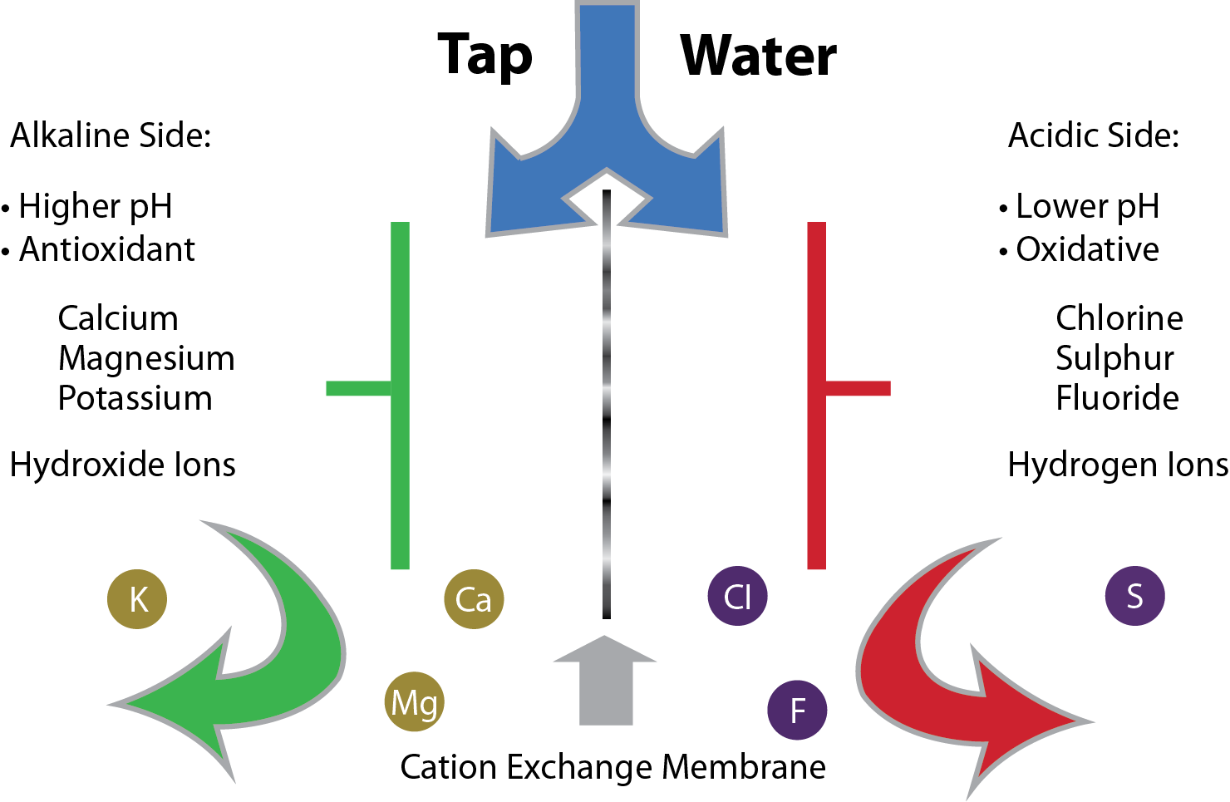
HOW DOES AN IONIZER WORK?
ELECTROLYSIS EXPLAINED
LifeIonizers.com
Notes:
‹#›
This is a diagram that also shows the process of electrolysis. You can see alkaline minerals and negative ions on the left side and acidic elements and positive unhealthy ions on the right side.

Slide 33
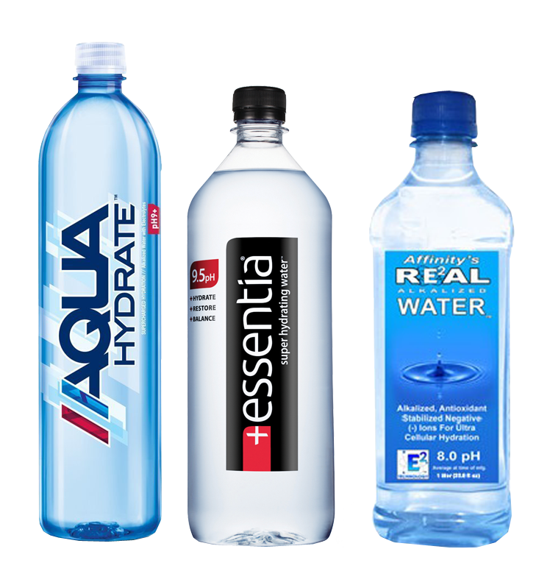
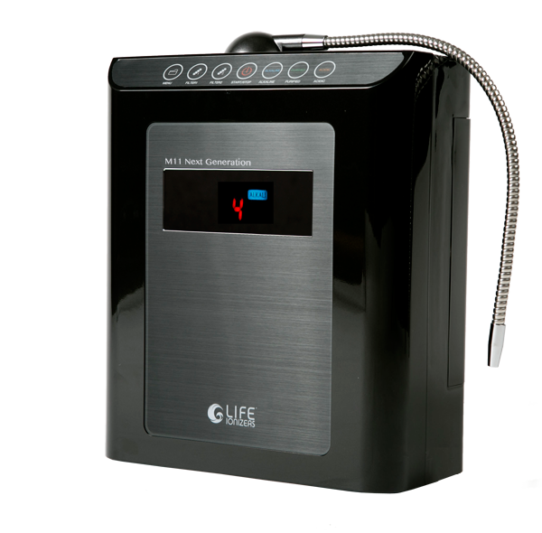
BOTTLED ALKALINE WATER vs.
Alkaline Ionized Water
Why Life Ionizers is the best choice for
water purity:
A LIFE Ionizer makes better water, protects you from the chemicals in bottled water, and saves you money. LIFE Ionizers has the best filtration of all water ionizers on the market today because Life Ionizers pulls your Federal Water Report, analyzes it, then builds a custom pre-filtration system that ensures your water is purified of toxins in it.
Bottled alkaline water is expensive:
You will save a lot of money in the long run by buying a life ionizer instead of a bottle of alkaline water. A life ionizer will be a one time purchase while buying bottled alkaline water will be an ongoing expense. With a Life alkaline water ionizer, you will save money, and have an unlimited supply of safe, healthy drinking water. If you continue to buy regular bottled water, your supply is always limited, and it would easily cost over $1,000 a year’s supply for one person!
Notes:
‹#›

Slide 34
BOTTLED ALKALINE WATER vs.
Alkaline Ionized Water
Help the Environment:
The problem is that plastic bottles create a lot of waste. You can have the same convenience by making ionized alkaline drinking water at home and putting it in one of Life’s stainless steel 750 ml bottles which preserve the pH and the ORP of the water. Life also has reusable 2.2 liter and 1 gallon BPA-free plastic bottles that you can fill with ionized alkaline water. In the United States, six out of seven bottles are not recycled. The toxins from these plastic bottles seep out into the soil and watersheds.
Actually Alkaline?
Bottled alkaline water shows the pH of their water at the time of bottling, but by the time you buy and are ready to enjoy your alkaline water, it could be back to neutral. The ORP or anti-oxidants within alkaline ionized water is one of the most beneficial aspects, but this is also one of the first things that dissipates after it is produced. This is why the benefits of alkaline ionized water can only be felt from a water ionizer and the water should be consumed within 72 hours.
A water ionizer uses far less energy and water to make healthy water and it’s a lot cheaper than bottled water. Another downside to bottled water is that it can contain chemicals like BPA. A water ionizer filters chemicals from your water so you can be assured the water is healthy for you.
Notes:
‹#›

Slide 35
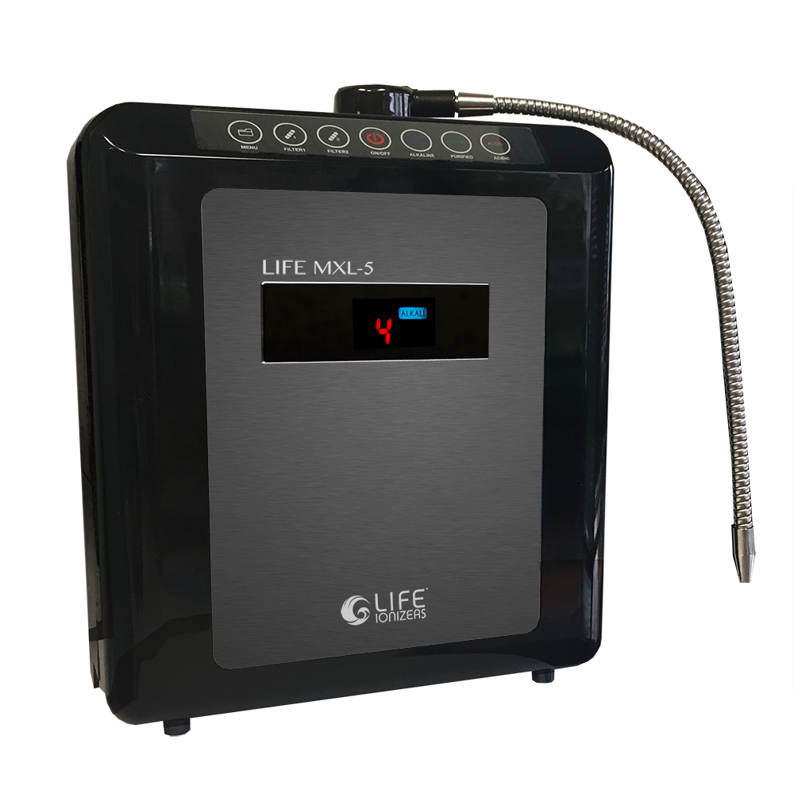
NEW 2018 MODEL
Life MXL-5 Water Ionizer
Counter Top Installation
5 Flat or XL Matrix GRID™ Plates
Up to 249 Watts | XL Power™ SMPS
Life MicroMembrane™ Technology
3.0 - 9.8 pH Range
Up to -500 ORP | Anti-Oxidant Potential
7 Year Warranty
Customized Pre-Filters
Top Loading One-Click Filters™
Advanced RADC Self-Cleaning
Black/Graphite | Color Options
Dimensions | 12.5" W x 6.25" D x 15" H
110v-220v International Voltage
Counter-top: $1,497
LifeIonizers.com
Notes:
‹#›

Slide 36
NEW 2018 MODEL
Life MXL-7 Water Ionizer
Countertop or Undercounter Installation
7 Flat or XL Matrix GRID™ Plates
Up to 450 Watts | XL Power™ SMPS
Life MicroMembrane™ Technology
2.5 - 11.0 pH Range
Up to -700 ORP | Anti-Oxidant Potential
Lifetime Parts Warranty / 10 Years Labor
Customized Pre-Filters
Top Loading One-Click Filters™
Advanced RADC Self-Cleaning
Black/Graphite | Color Options
Dimensions | 12.5" W x 6.25" D x 15" H
110v-220v International Voltage
Counter-top: $1,997
Undercounter: $2,497
LifeIonizers.com
Notes:
‹#›

Slide 37
NEW 2018 MODEL
Life MXL-9 Water Ionizer
Countertop or Undercounter Installation
9 Flat or XL Matrix GRID™ Plates
Up to 504 Watts | XL Power™ SMPS
Life MicroMembrane™ Technology
2.0 - 11.5 pH Range
Up to -800 ORP | Anti-Oxidant Potential
Lifetime Warranty
Customized Pre-Filters
Top Loading One-Click Filters™
Advanced RADC Self-Cleaning
Black/Graphite | Color Options
Dimensions | 12.5" W x 6.25" D x 15" H
110v-220v International Voltage
Counter-top: $2,497
Undercounter: $2,997
LifeIonizers.com
Notes:
‹#›

Slide 38
NEW 2018 MODEL
Life MXL-11 Water Ionizer
Countertop or Undercounter Installation
11 Flat or XL Matrix GRID™ Plates
Up to 800 Watts | XL Power™ SMPS
Life MicroMembrane™ Technology
2.0 - 12.0 pH Range
Up to -880 ORP | Anti-Oxidant Potential
Lifetime Warranty
Customized Pre-Filters
Top Loading One-Click Filters™
Advanced RADC Self-Cleaning
Black/Graphite | Color Options
Dimensions | 12.5" W x 6.25" D x 15" H
110v-220v International Voltage
Counter-top: $2,997
Undercounter: $3,497
LifeIonizers.com
Notes:
‹#›

Slide 39
NEW 2018 MODEL
Life MXL-13 Water Ionizer
Countertop or Undercounter Installation
13 Flat or XL Matrix GRID™ Plates
Up to 800 Watts | XL Power™ SMPS
Life MicroMembrane™ Technology
1.7 - 12.2 pH Range
Up to -900 ORP | Anti-Oxidant Potential
Lifetime Warranty
Customized Pre-Filters
Top Loading One-Click Filters™
Advanced RADC Self-Cleaning
Black/Graphite | Color Options
Dimensions | 12.5" W x 6.25" D x 15" H
110v-220v International Voltage
Counter-top: $3,497
Undercounter: $3,997
LifeIonizers.com
Notes:
‹#›

Slide 40
NEW 2018 MODEL
Life MXL-15 Water Ionizer
Countertop or Undercounter Installation
15 Flat or XL Matrix GRID™ Plates
Up to 800 Watts | XL Power™ SMPS
Life MicroMembrane™ Technology
1.7 - 12.2 pH Range
Up to -1005 ORP | Anti-Oxidant Potential
Lifetime Warranty
Customized Pre-Filters
Top Loading One-Click Filters™
Advanced RADC Self-Cleaning
Black/Graphite | Color Options
Dimensions | 12.5" W x 6.25" D x 15" H
110v-220v International Voltage
Counter-top: $3,997
Undercounter: $4,497
LifeIonizers.com
Notes:
‹#›

Slide 41
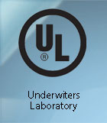
LIFE IONIZERS
CERTIFICATIONS
Notes:
‹#›

Slide 42
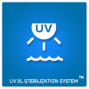
ADDITIONAL TECHNOLOGIES
5-STAGE REVERSE OSMOSIS: $299
REMINERALIZER: $75
SUPER PRE-FILTER SYSTEM: $189.97
LIFE GRID TECHNOLOGY: $100
LIFE UV LIGHT TECHNOLOGY: $150
LIFE ENERGY FREQUENCY TECHNOLOGY: $150
LIFE LASER ENERGY TECHNOLOGY: $300
NO SALES TAX (EXCL. CA RESIDENTS)
LifeIonizers.com
Notes:
‹#›

Slide 43
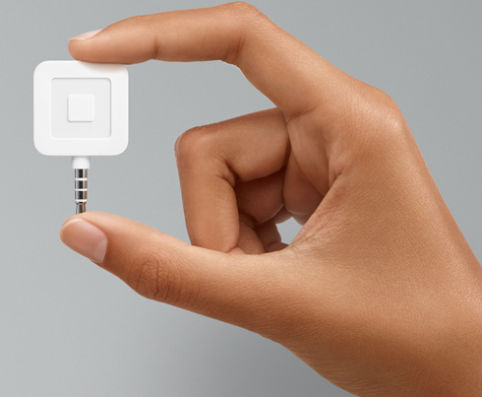
OPTIONS
FOR CHARGING YOUR CLIENT
PAYPAL
SQUARE
https://www.paypal.com/home
FEES BETWEEN 1-3%
https://squareup.com/
FEES BETWEEN 1.4% AND 2.0%
LifeIonizers.com
Notes:
‹#›

